Slide 1


Symptom-based Disease Prediction
Presented By:-
Vanshita Patel(20BIT157D)
Manan Gandhi(20BIT165D)
University Supervisor :-
Dr. Soumyashree Panda
Industry Supervisor :-
Dipali Patel

Slide 2

Introduction To Company (Sparks To Ideas)
Introduction :- Complete software solution company partner in India and USA provides software as per client requirements and helps to grow business with new technologies. (We Design, We Develop, We Promote)
Services :- Web Development, Mobile App Development, UI-UX Design, SEO, QA & Testing, E-Commerce Development, CMS, API Integration
Company founded in :- 2015
Company's website:-https://www.sparkstoideas.com/
Industry :- IT Services & IT Consulting
Company Size :- 11-50 employees (74 associated members)
Headquarters :- Ahmedabad, Gujarat

Slide 3
Introduction
Analyzing historical medical data, patient symptoms, and relevant health indicators to generate predictions.
Django, a high-level Python web framework, used for building the web application interface and managing data.
Machine learning algorithms are employed to process the data and generate predictions about potential diseases based on observed symptoms.
This platform gives customers the ability to get medical advice and assistance from the comfort of their homes, intending to improve healthcare accessibility and efficiency.

Slide 4
Problem Statement
Develop a symptom-based disease prediction system that makes use of machine learning techniques to determine diseases based on symptoms reported by users.
Objectives:
Provide a simple interface that enables users to enter their symptoms and obtain specific predictions for their diseases.
Allow users to quickly consult doctors and get the right medical advice by integrating the system with Django.
By regularly adding new data to the system and improving the machine learning models, you can raise the accuracy of disease predictions.

Slide 5
Motivation
Improve healthcare accessibility: Provide a system that enables patients to consult with doctors remotely and receive an initial diagnosis. Reduce the number of in-person appointments, particularly for patients who live far away or have limited transportation.
Early detection and intervention: Provide the early identification of illnesses based on symptoms, which will allow for quick treatment and better patient outcomes. Give patients the chance to seek out medical guidance and care as soon as possible.
Personalized healthcare: Make individualized disease predictions by analyzing patient symptoms using machine learning algorithms. Improve the precision of treatment recommendations and diagnosis based on unique patient characteristics.

Slide 6
Literature Gaps
Increasing the number of diseases and Develop a real-time disease prediction system that can provide instant feedback and recommendations based on user input.[1]
The study does not explore the potential benefits of combining the Naïve Bayes, Decision Tree, and Random Forest with ensemble methods. For Future research we can focus on implementing techniques such as oversampling, under sampling, or synthetic data generation to handle class imbalance and improve the algorithm's predictive capabilities.[2]
Need to improv the user interface and user experience of the disease prediction system to make it more accessible and user-friendly for both healthcare professionals and patients. [3]
Lack of detailed discussion on the potential challenges and limitations of implementing the proposed disease prediction model in real-world healthcare settings. Addressing practical considerations such as data privacy, regulatory compliance, and integration with existing systems will be crucial. [4]
Collaborating with healthcare providers and institutions to implement the predictive models in clinical settings and validate their effectiveness in real-world scenarios. [5]

Slide 7
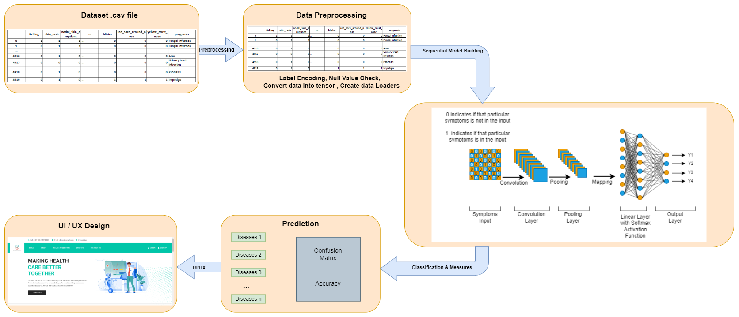
Methodology

Slide 8
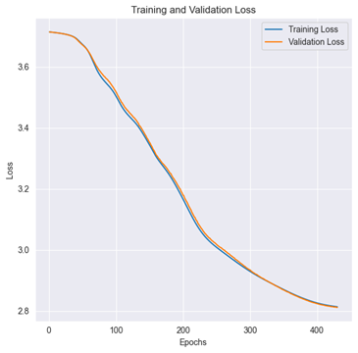
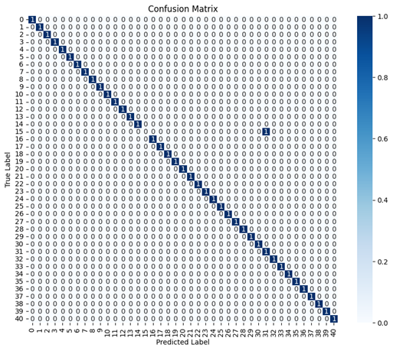
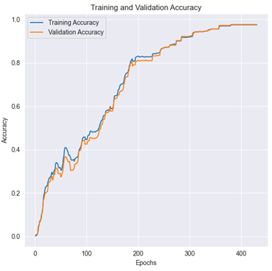
Results
Model Accuracy Versus Epochs Plot for Training and Validation
Model Loss Versus Epochs Plot for Training and Validation
Confusion Matrix

Slide 9
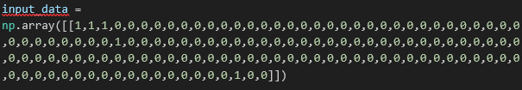
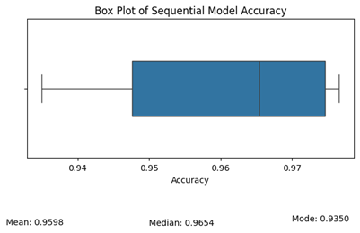
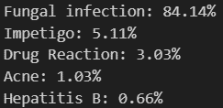
Results
Prediction Model Input
Prediction Model Output
Box Plot for Sequential Model with SoftMax Activation Function

Slide 10
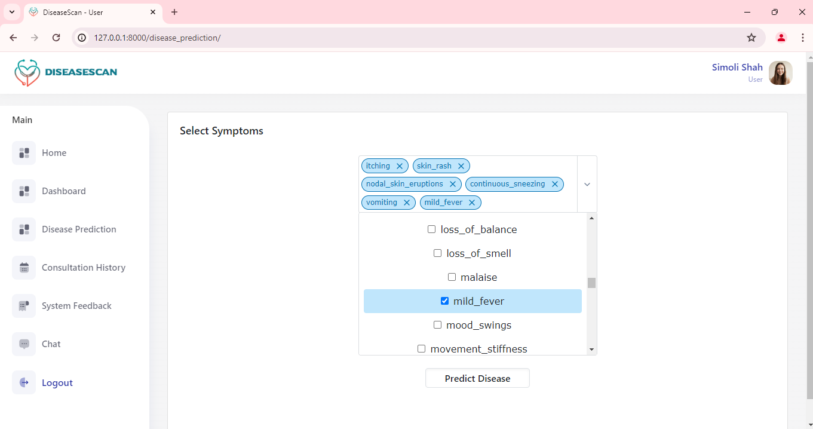
Web Development Results

Slide 11
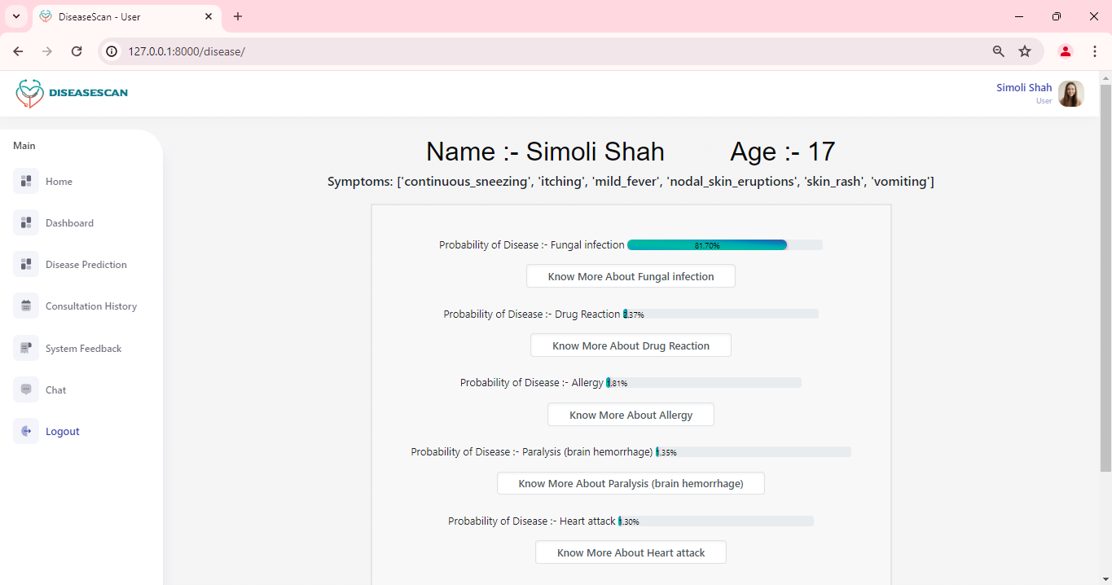
Web Development Results

Slide 12
Conclusion
The Sequential Model with SoftMax activation function performed best compared to other machine learning algorithms in symptom-based disease prediction.
SVM, Gradient Boosting, Random Forest, and Decision Trees are difficult to understand, sensitive to parameters, prone to overfitting.
The Sequential Model with SoftMax activation function uses Convolutional Neural Network (CNN) architecture to capture complex spatial correlations in symptom data.
This model demonstrated superior prediction accuracy and generalization ability during both training and validation stages.
The SoftMax activation function introduced non-linearity, enabling the model to recognize intricate connections and patterns in the data.
Combining CNN with SoftMax improved interpretability and ensured consistent and reliable predictions across various clinical scenarios.

Slide 13

Future Scope
Data Collection and Feedback Mechanisms
Model Adaptation and Continuous Learning
User-Centric Design and Transparency
Enhanced Healthcare Decision-Making
Scalability and Performance Optimization
Ethical and Regulatory Considerations

Slide 14
Reference
[1] R. Keniya et al., “Disease prediction from various symptoms using machine learning,” Social Science Research Network, Jan. 2020, doi: 10.2139/ssrn.3661426.
[2] Mr. S. L. Pais, F. A. K, Sharanya, Shrihastha, and Varshith, “Disease Prediction using Machine Learning Algorithms,” International Journal of Advanced Research in Science, Communication and Technology, pp. 5–12, Jan. 2023, doi: 10.48175/ijarsct-7825.
[3] M. V. K. Reddy, “Disease predictor based on symptoms using machine learning,” International Journal for Research in Applied Science and Engineering Technology, vol. 10, no. 6, pp. 2549–2555, Jun. 2022, doi: 10.22214/ijraset.2022.44408.
[4] K. Gaurav, A. Kumar, P. K. Singh, A. Kumari, M. Kasar, and T. Suryawanshi, “Human Disease Prediction using Machine Learning Techniques and Real-life Parameters,” International Journal of Engineering. Transactions C: Aspects, vol. 36, no. 6, pp. 1092–1098, Jan. 2023, doi: 10.5829/ije.2023.36.06c.07.
[5] A. Rayan, “Identification and prediction of chronic diseases using machine learning approach,” Journal of Healthcare Engineering, vol. 2022, pp. 1–9, Feb. 2022, doi: 10.1155/2022/2826127.

Slide 15

THANK YOU

Slide 16
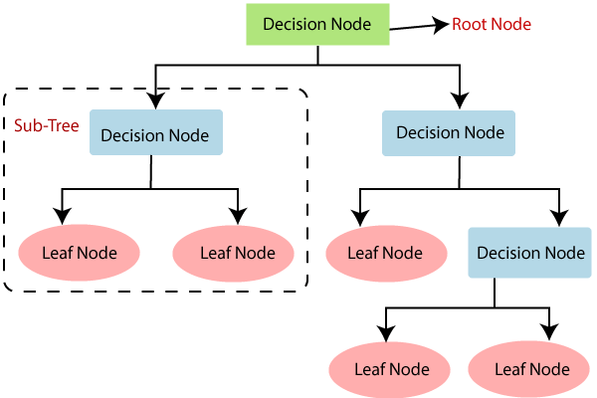
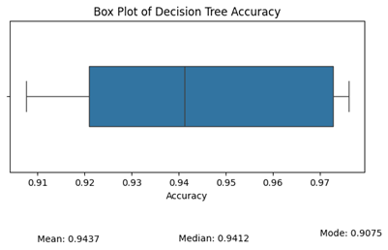
Decision Tree
Architecture
Box Plot(5 times model training)

Slide 17
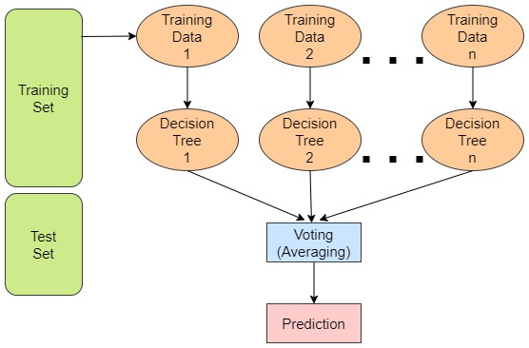
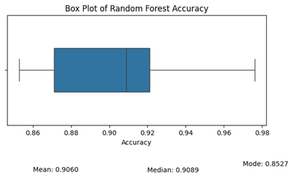
Random Forest
Box Plot(5 times model training)
Architecture

Slide 18
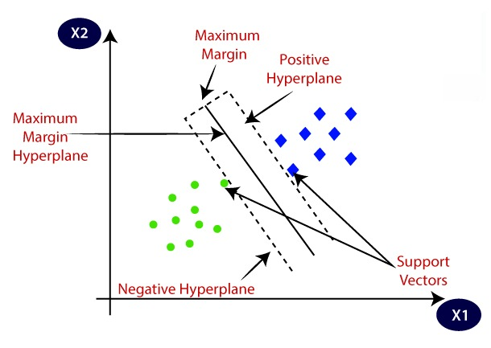
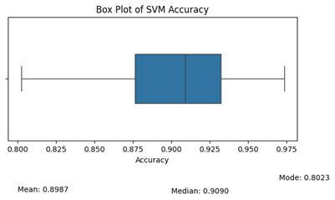
Support Vector Machine
Box Plot(5 times model training)
Architecture

Slide 19
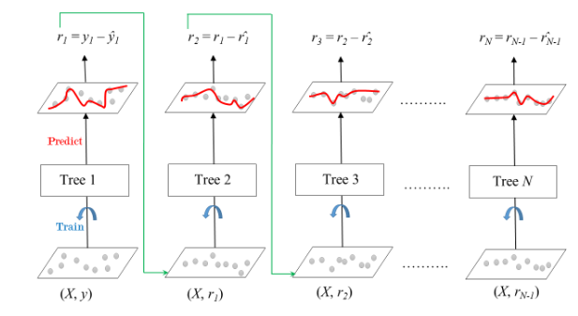
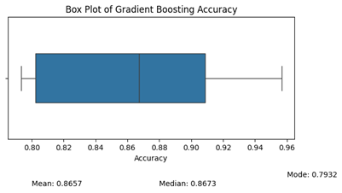
Gradient Boosting
Box Plot(5 times model training)
Architecture

